Slide 1

Vaccine Centre
Submitted To: Submitted By:
Mr. Anik Sen Antar Nandi
Assistant Professor Id: 1603110201203
Department of Computer Science & Engineering
Premier University, Chittagong.

Slide 2
Introduction
“Vaccine Center” is a system that helps users to get vaccine. It helps Admin of this system to keep all the information about vaccines and patients. Admin of this system can add vendor and purchases vaccine from them. Users can get vaccine from this system and automated reminders are sent by “Vaccine Center” so that users can get update about their upcoming vaccination date. Admin of this system keep track of stored and sold vaccines. He can also see total sold vaccines and revenue from this system.

Slide 3
Goal
The main goal is to build this application “Vaccine Center” which will give the facilities to keep track of all information of vaccines and patients through database system

Slide 4
Related Work
Evercare Hospital Limited [1]
Evercare hospital vaccination system help user to get necessary information about different kind of vaccines stop paying for things you no longer need.
United Hospital Limited [2]
The Vaccination Center of United Hospital is providing its keen continues services. This department serves the indoor neonates, children & Adult by providing life savings vaccines.

Slide 5
Motivation
There are many vaccination center and they maintain their vaccines information and other details using hand written documents. But the main motive is to build this application “Vaccine Center” which will give the facilities to keep track of all information of vaccines and patients through database system.

Slide 6
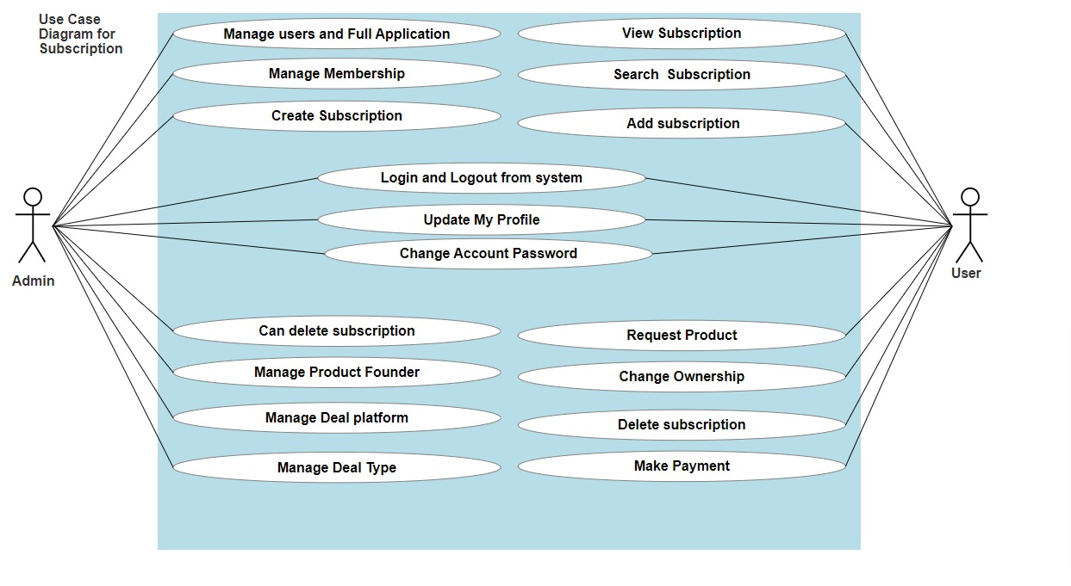
Use Case Diagram of the system

Slide 7
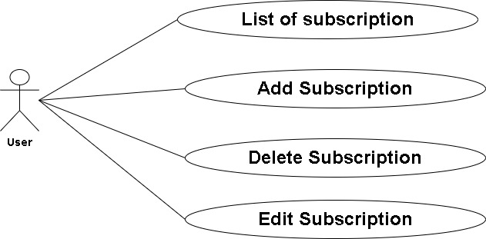
Use Case Diagram (Contd)
Manage Subscriptions

Slide 8
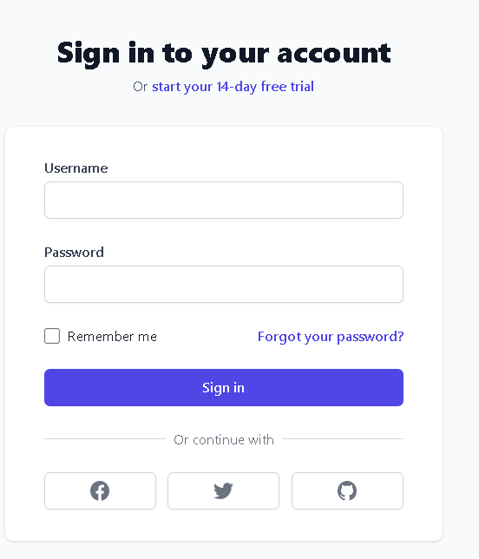
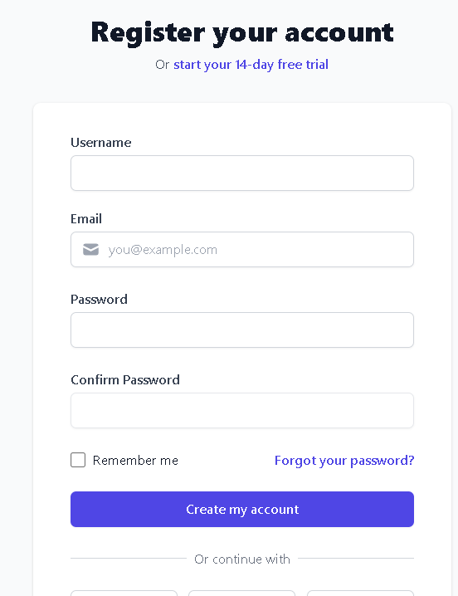
Features of Authentication
Log in
Register

Slide 9
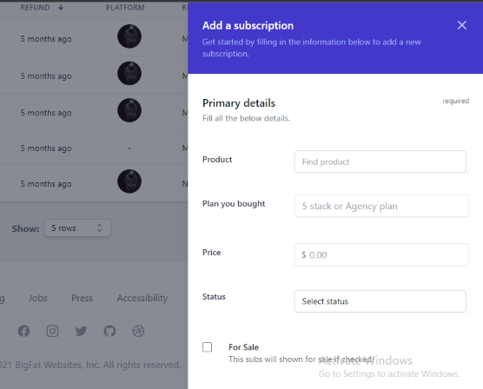
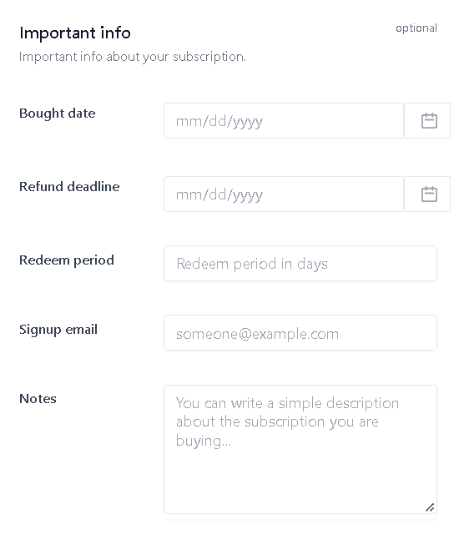
Features of User
Add Subscription

Slide 10
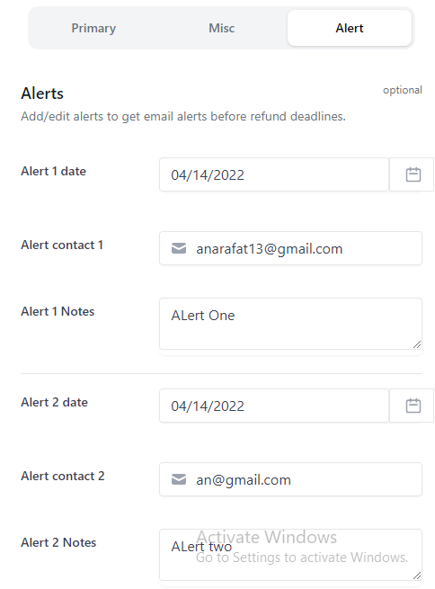
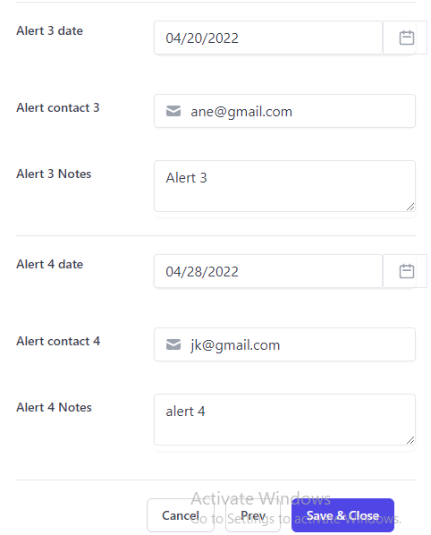
Features of User (Contd)
Alert

Slide 11
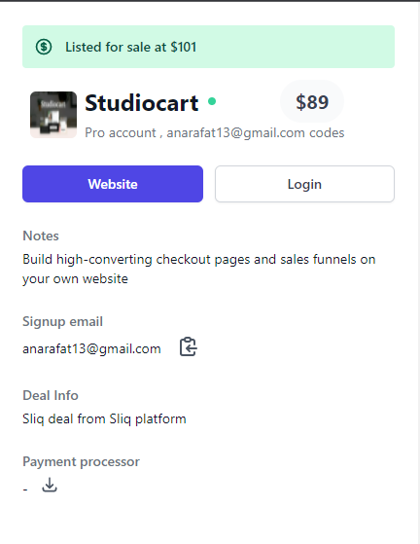
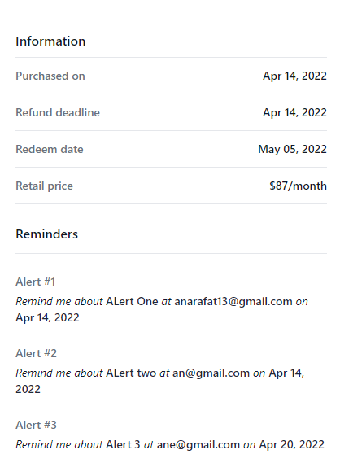
Features of User (Contd)
Subscription details

Slide 12
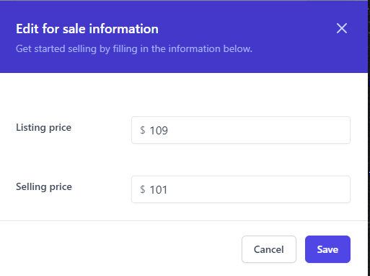
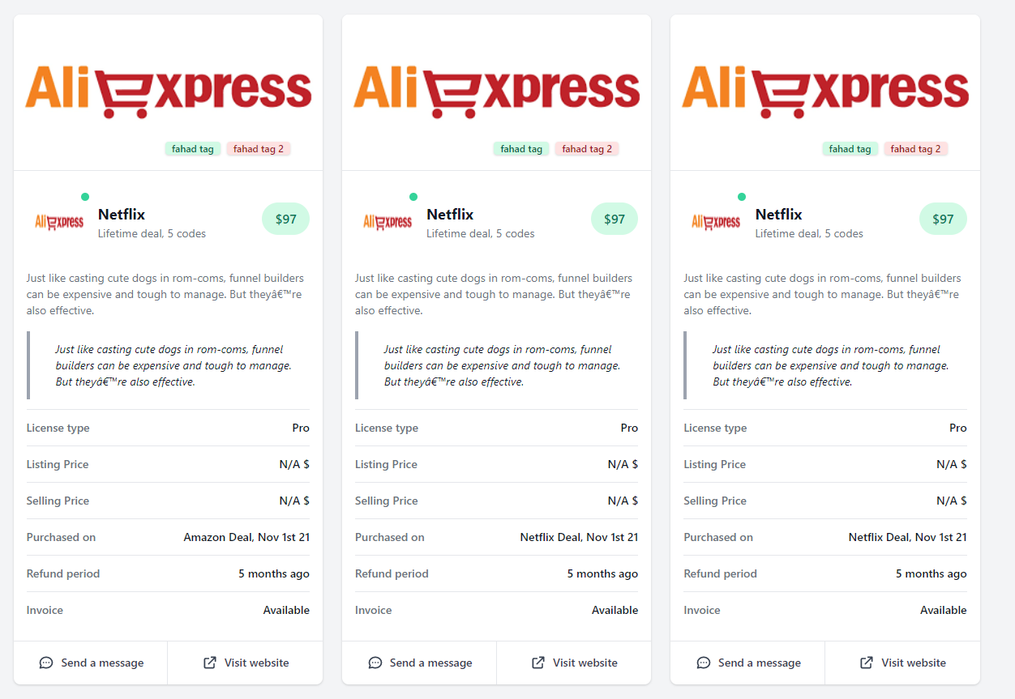
Features of User (Contd)
Recycle Subs info
Recycled Subs list

Slide 13
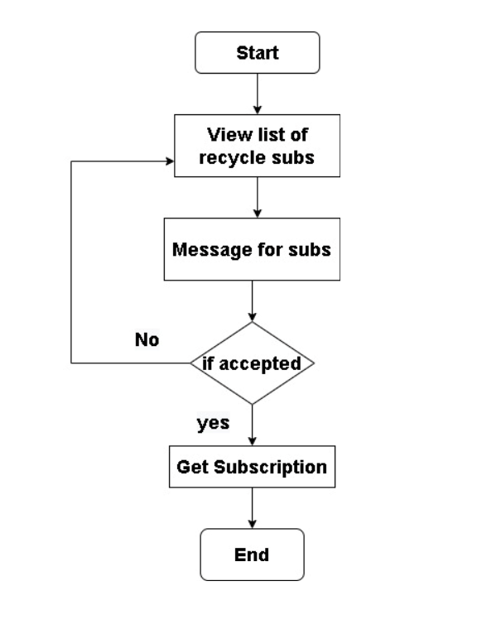
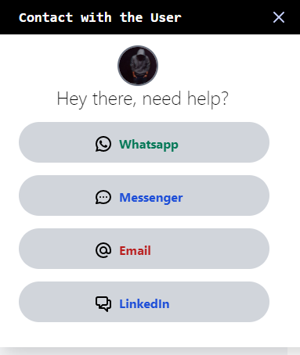
Features of User (Contd)
Change Ownership

Slide 14
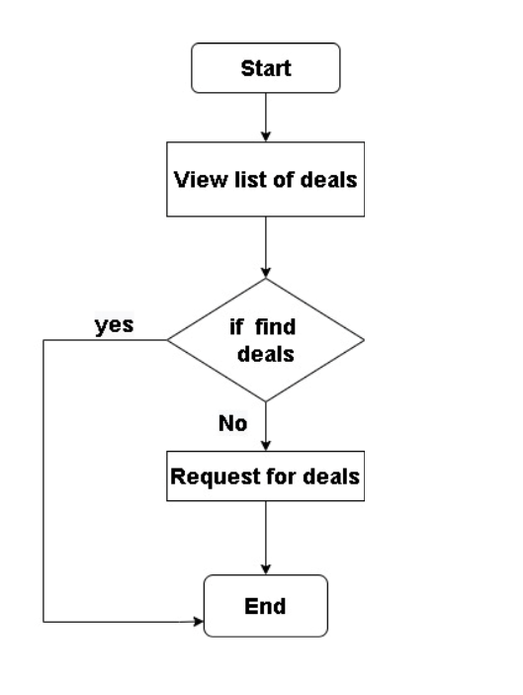
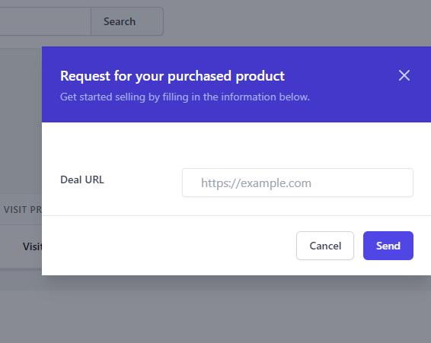
Features of User (Contd)
Request Product

Slide 15
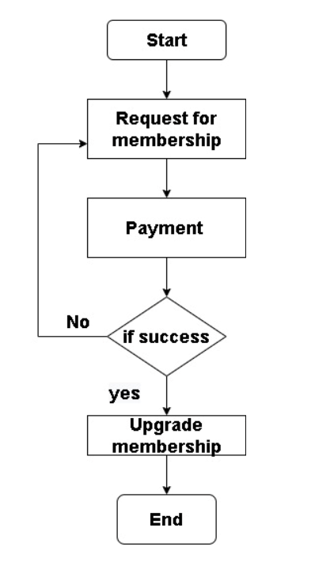
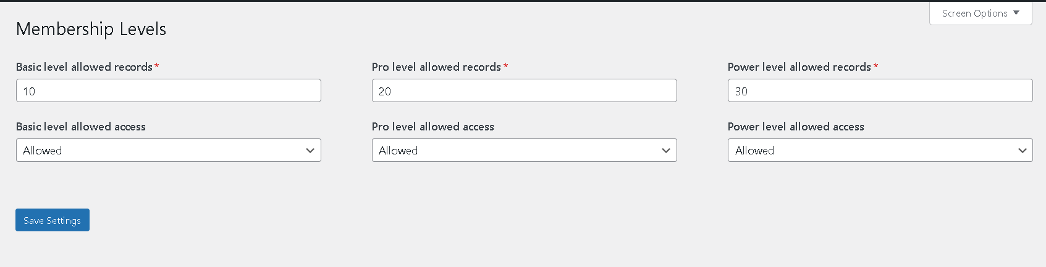
Features of Admin
Manage Membership

Slide 16
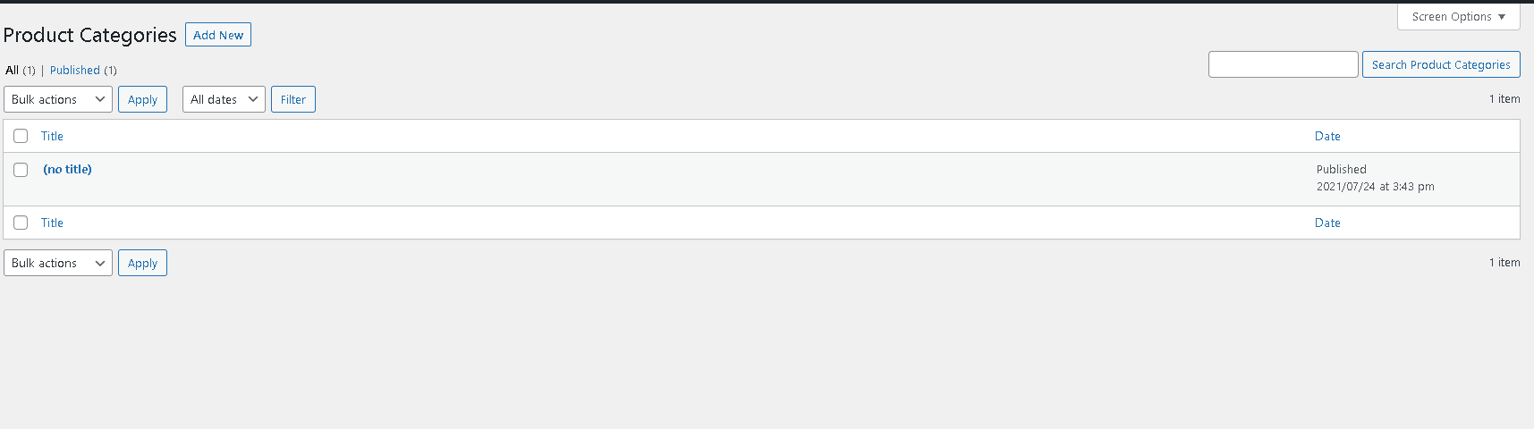
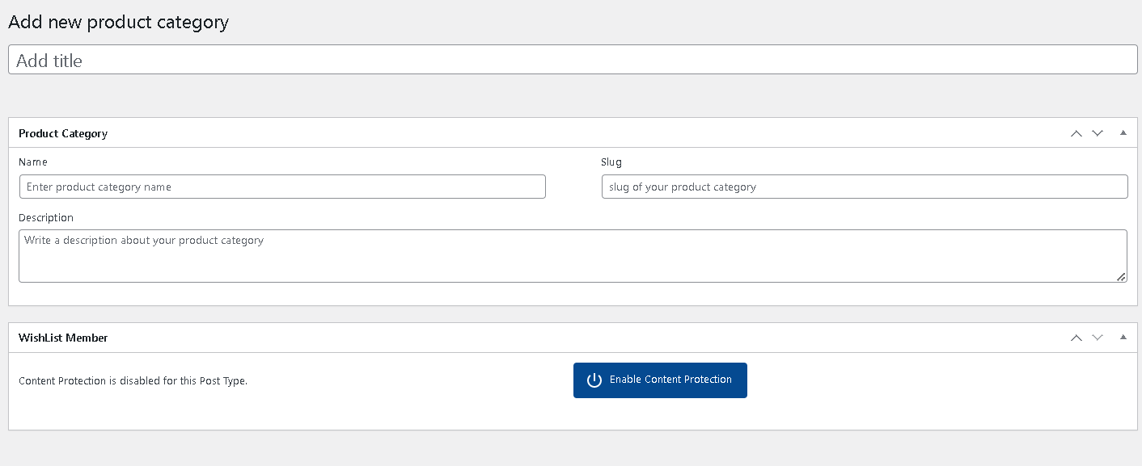
Features of Admin (Contd)
Deal Categories
Add new Deal Category

Slide 17
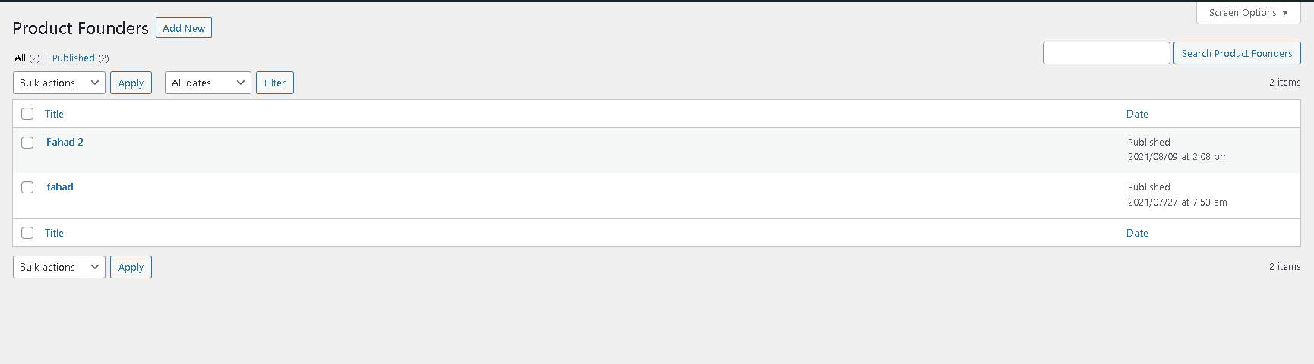
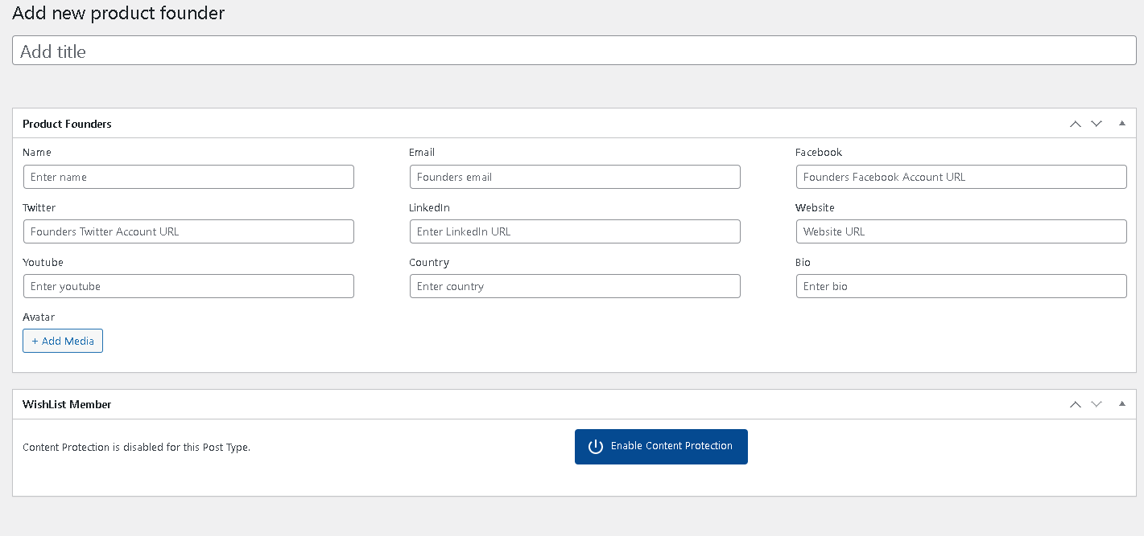
Features of Admin (Contd)
Deal Founders
Add new Deal Founder

Slide 18
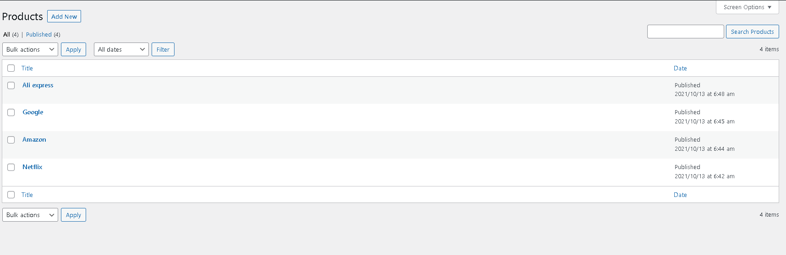
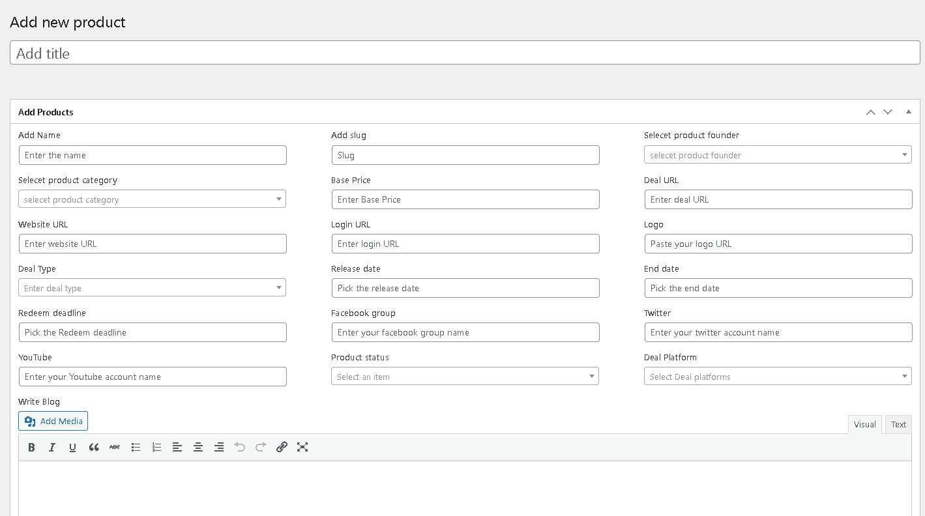
Features of Admin (Contd)
Deals
Add New Deal

Slide 19
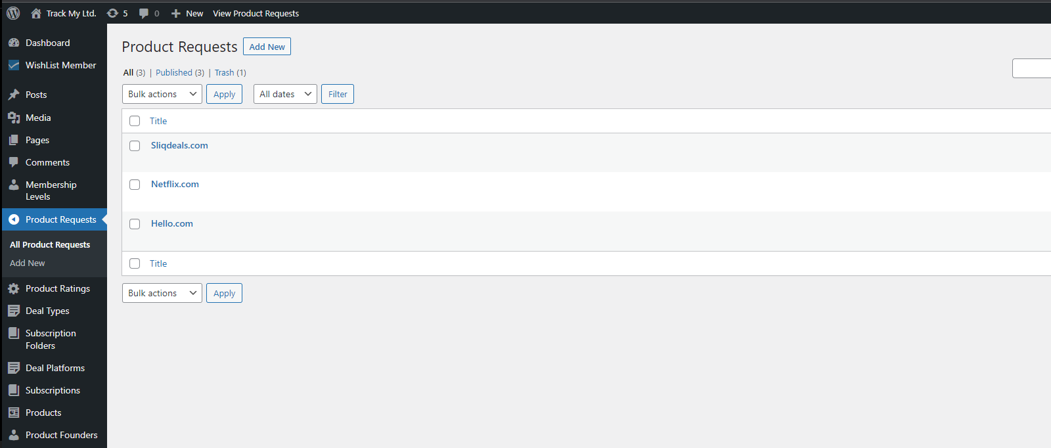
Features of Admin (Contd)
Requested Product

Slide 20
Limitations & Future Works
In my current system only admin can manages this system
In my future system I will develop user system also so that any use can take appointment for their vaccination.
Will develop a chat system so that user can communicate with vaccination center owner.
Will integrate payment gateway.

Slide 21
Technologies
HTML
CSS
Bootstrap
Laravel
Jquery
Ajax
MySQL

Slide 22
Conclusion
“Track My Subscription” is a subscription monitoring tool featuring notifications, reminders, and payment type control
It delivers automated reminders and warnings to avoid unnecessary subscriptions
It allows users to track spending month-to-month and estimate remaining budget for the current month
And Also changing ownership of purchasing subscriptions
Integrated SPA (vue.js) inside wordpress

Slide 23
References
[1] https://www.truebill.com/feature/manage-subscriptions [Accessed on: 31 March, 2022].
[2] https://money.usnews.com/money/personal-finance/saving-and-budgeting/articles/track-and-manage-subscriptions-with-these-apps [Accessed on: 31 March, 2022].
[3] https://appsumo.com/products/subscription-tracker-and-management-notion/ [Accessed on: 31 March, 2022].
[4] https://www.guru99.com/what-is-php-first-php-program.html [Accessed on: 1 April, 2022].
[5] https://www.techtarget.com/searchcontentmanagement/definition/WordPress [Accessed on: 1 April, 2022].
[6] https://community.codenewbie.org/lanrewaju/100daysofcode-chapter-1-html-and-css-basics-3 709#:~:text=What%20is%20HTML%3F,for%20web%20 pages%20and%20applications. [Accessed on: 1 April, 2022].
[7] https://developer.mozilla.org/en-US/docs/Learn/CSS/First_steps/What_is_CSS [Accessed on: 1 April, 2022].
[8] https://en.wikipedia.org/wiki/JavaScript [Accessed on: 1 April, 2022].
[9] https://v2.vuejs.org/v2/guide/?redirect=true [Accessed on: 1 April, 2022].
[10] https://www.siteground.com/tutorials/php-mysql/mysql/#:~:text=MySQL%20is%20a%20fre ely%20available,ease%20and%20flexibility%20of%20use [Accessed on: 1 April, 2022].
[11] https://www.geeksforgeeks.org/introduction-to-tailwind- css/#:~:text=Tailwind%20CSS%20is%20basically%20a,have%20to%20fight%20to%20override [Accessed on: 1 April, 2022].

Slide 24
References (Contd)
[12] https://www.toppr.com/ask/question/web-server/ [Accessed on: 1 April, 2022].
[13] https://www.wpbeginner.com/glossary/apache [Accessed on: 1 April, 2022].
[14] https://www.webopedia.com/definitions/browser/ [Accessed on: 1 April, 2022].
[15] https://code.visualstudio.com/docs [Accessed on: 1 April, 2022].
[16] https://en.wikipedia.org/wiki/XAMPP [Accessed on: 1 April, 2022].

Slide 25
Thank you

Slide 26
Appendix

Slide 27
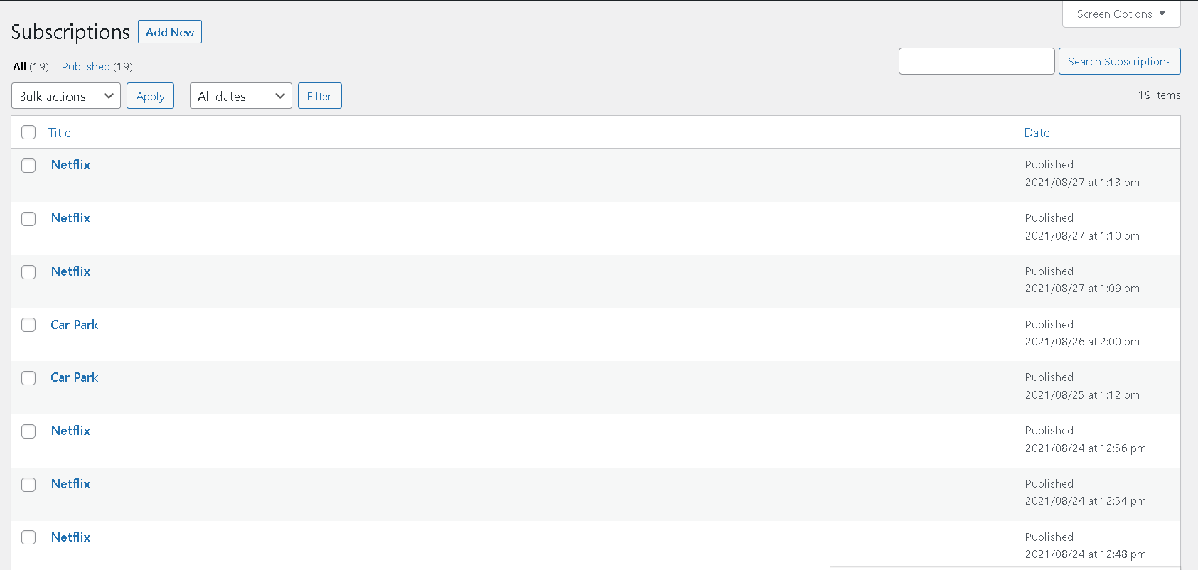
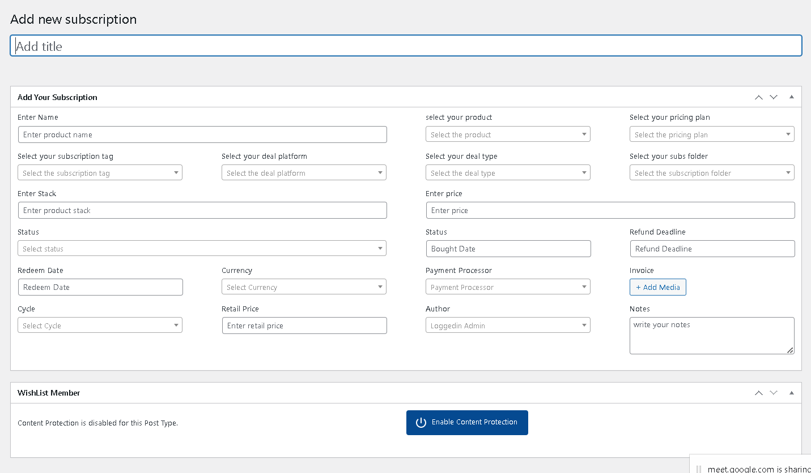
Features of Admin (Contd)
Subscriptions
Add New Subscriptions

Slide 28
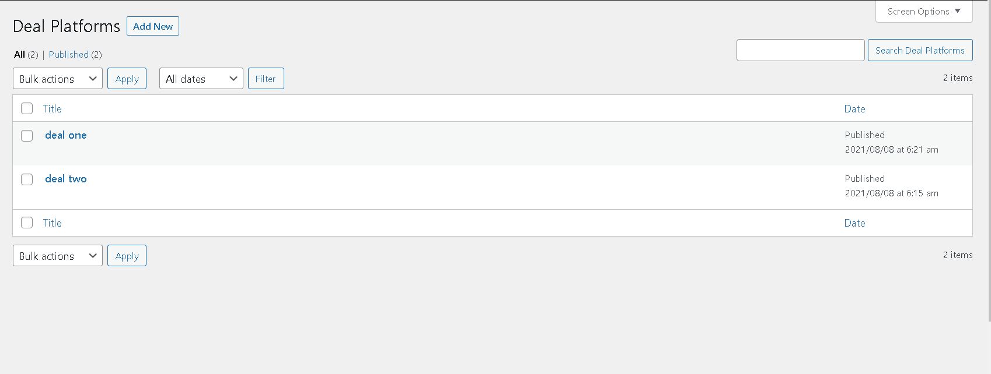
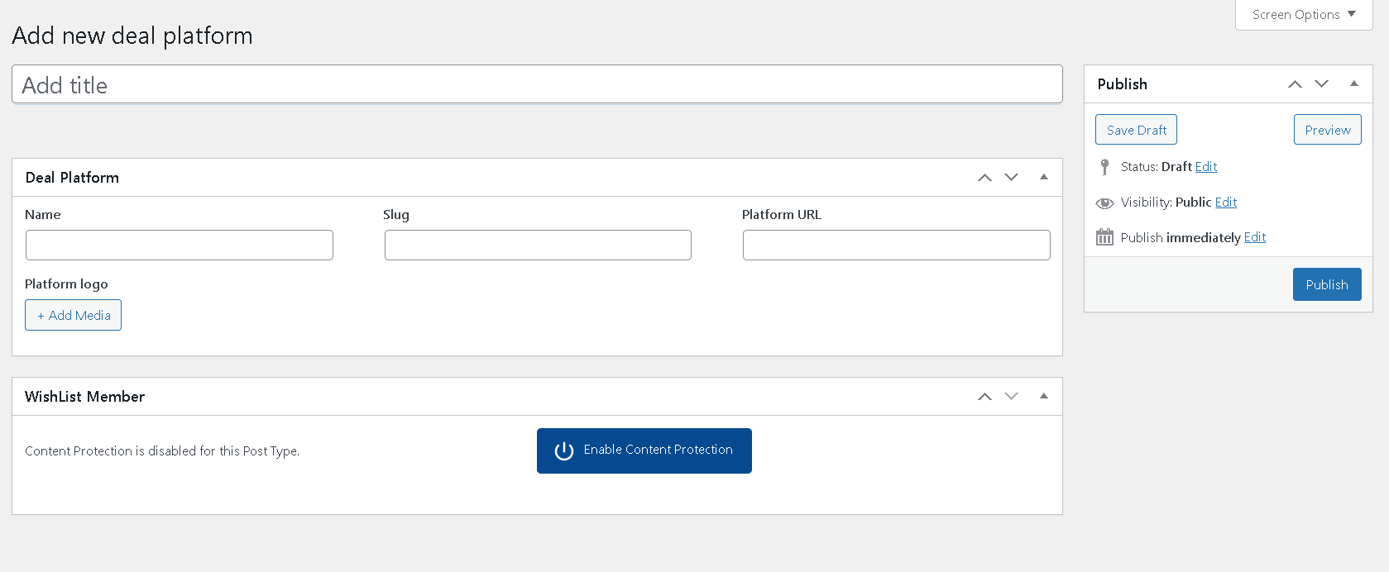
Features of Admin
Deal Platform
Add New Deal Platform

Slide 29
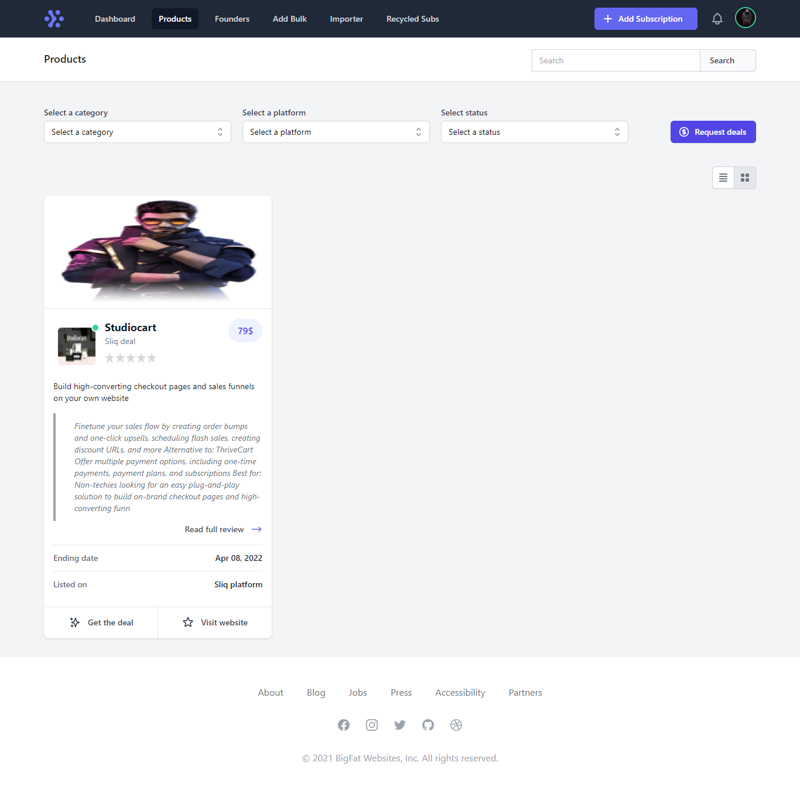
Features of User
Subs for sale info
Products

Slide 30
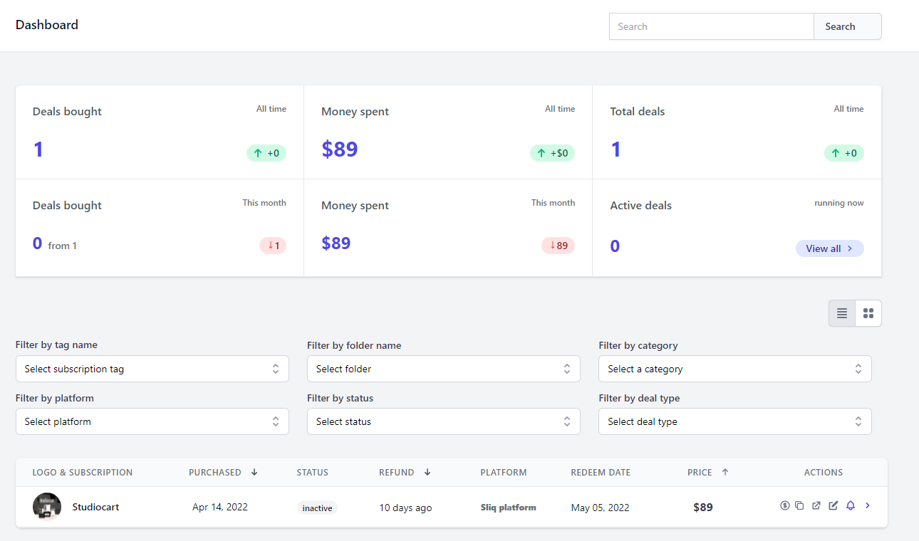
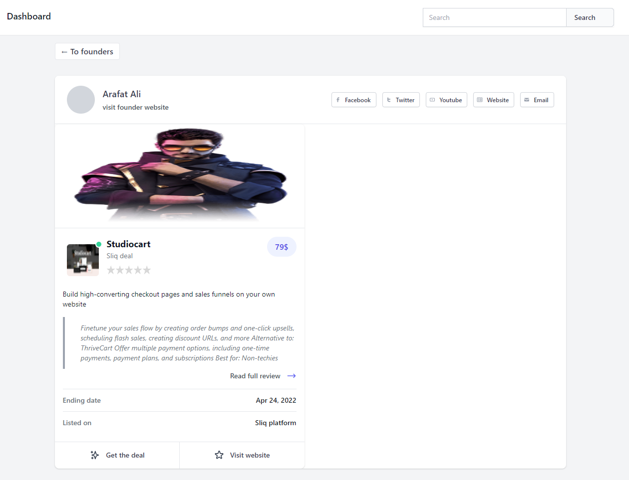

Slide 31
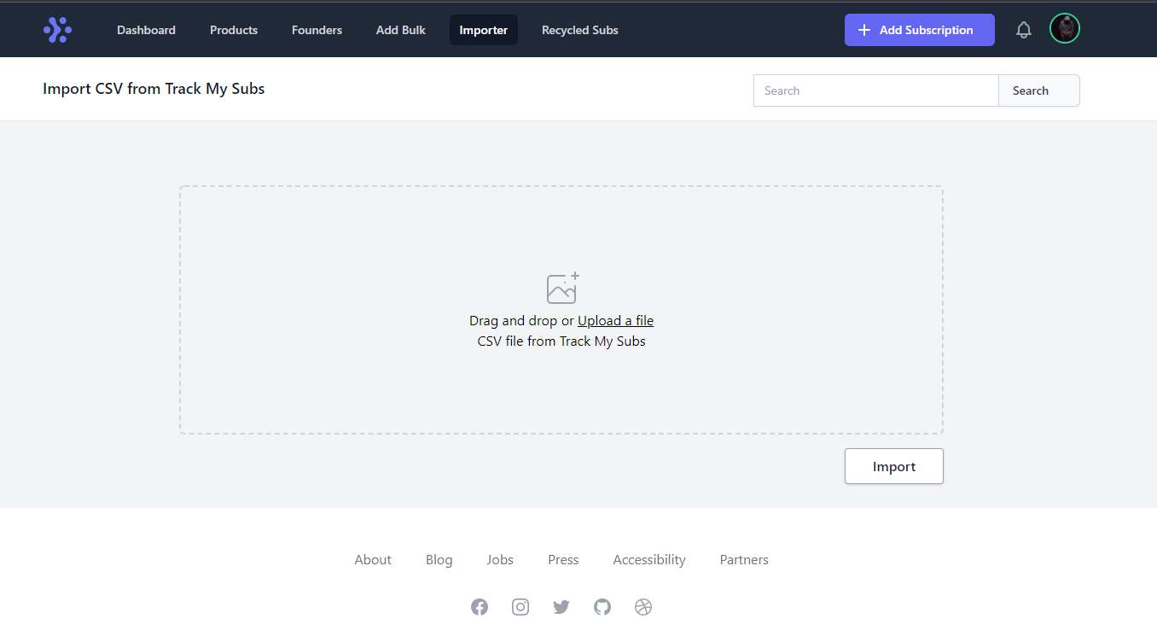
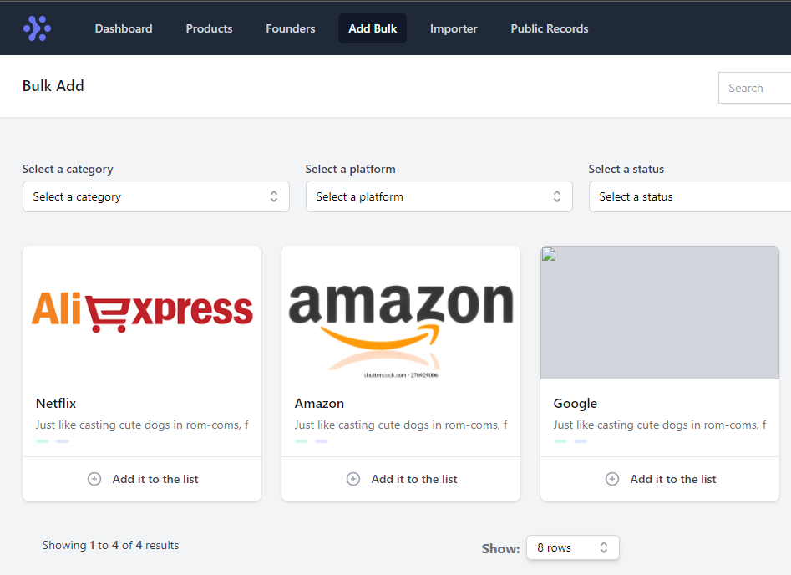

Slide 32
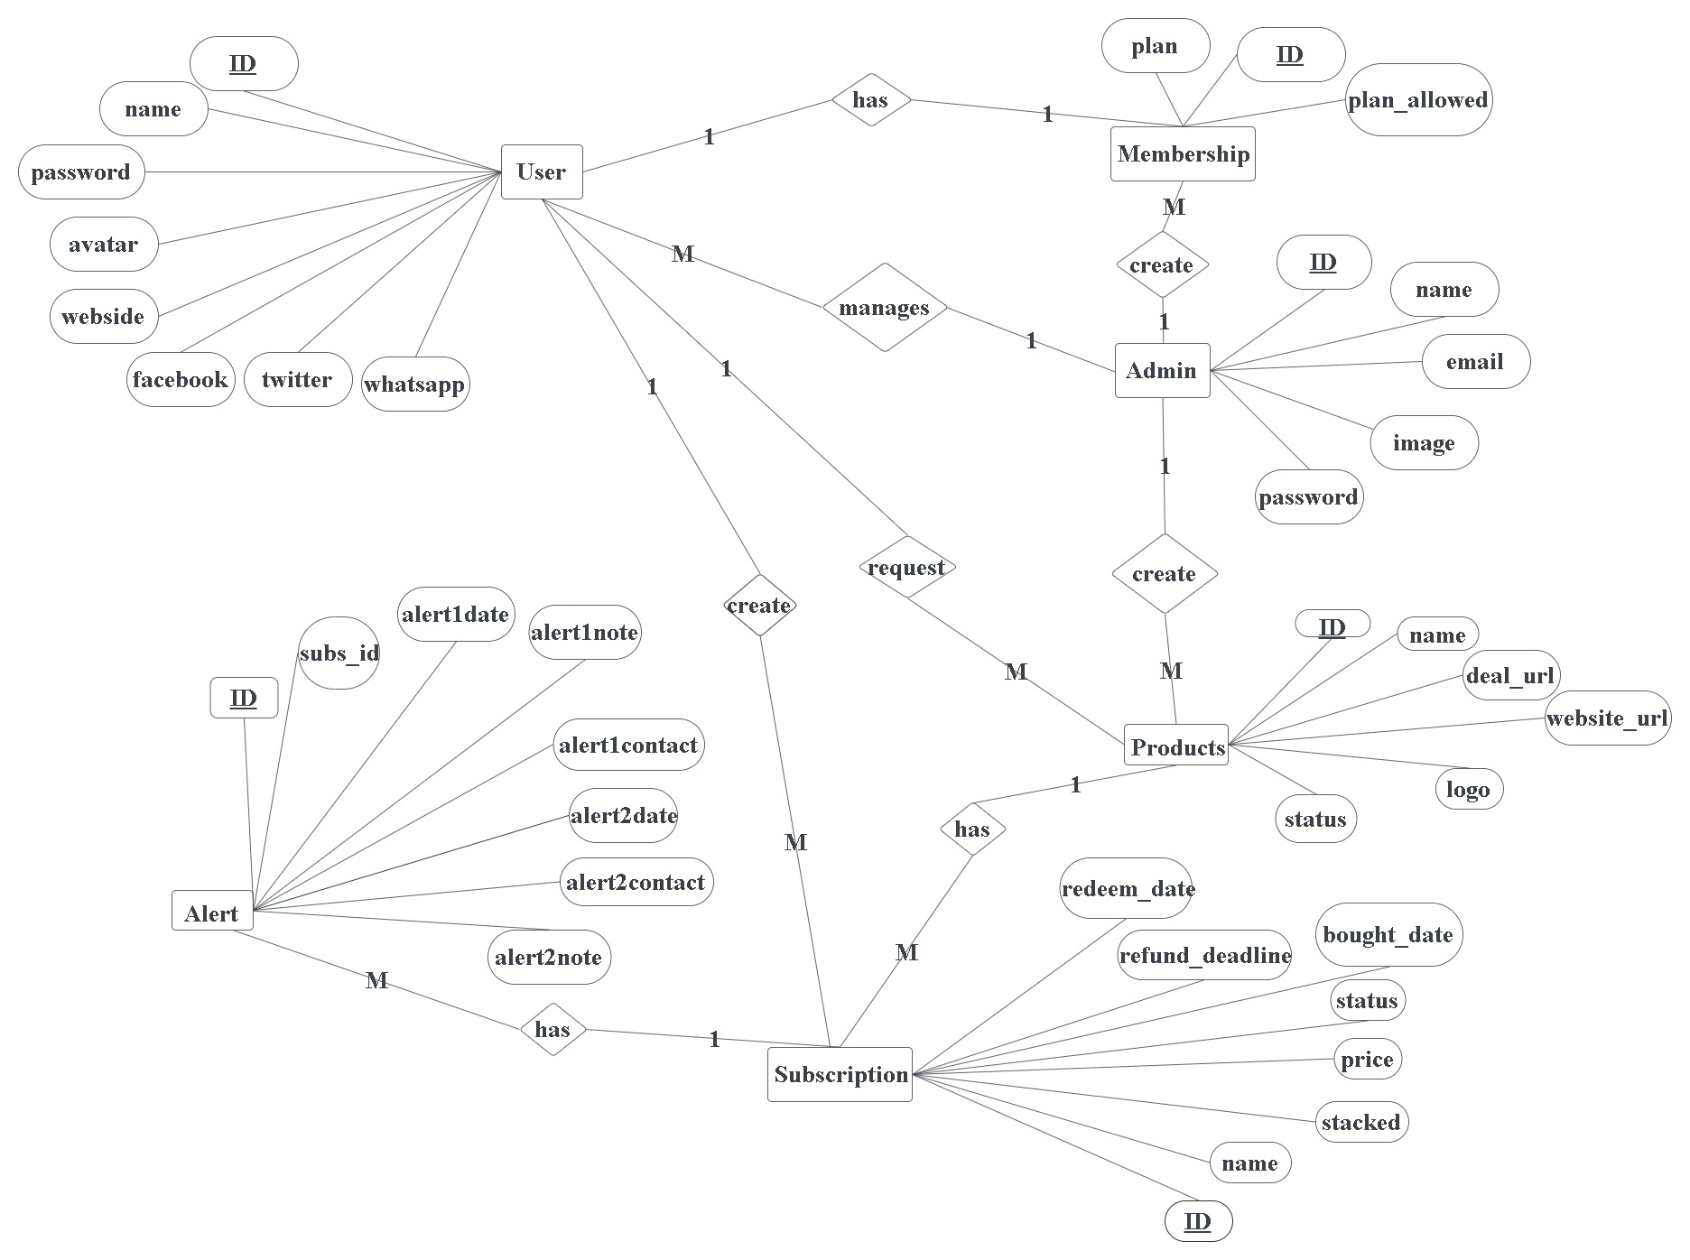
ER Diagram

